Slide 1

Week 09 : Lecture 17

Slide 2

Today’s lecture Breakdown:
Revision of previous lecture
Cache write strategies
Cache Questionnaire

Slide 3
Up coming events
QUIZ :
LABS :
Final Term Project

Slide 4
Basic Memory Terminologies :
Location
Capacity/Unit of transfer
Access method
Performance
Physical characteristics

Slide 5
Location :
CPU (On Chip)
Internal (Main Memory)
External (Hard disk)
Capacity :
Number of words
Number of bytes
Unit of transfer
Word
Block

Slide 6
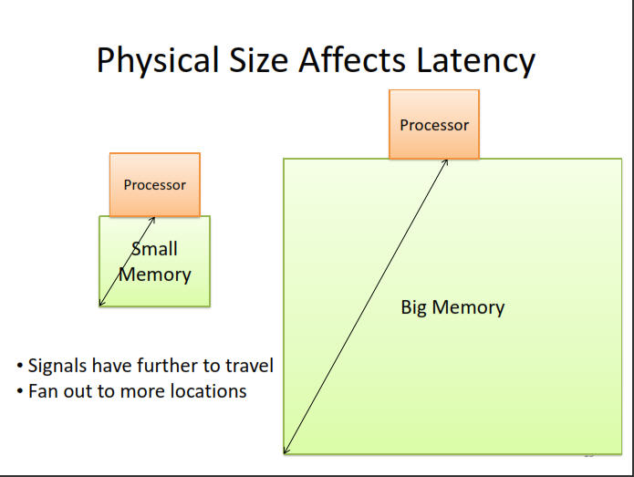
Capacity :

Slide 7
Memory Access Methods :
Sequential
Start at the beginning and read through in order
Access time depends on location of data and previous location
e.g. tape
Direct
Individual blocks have unique address
Access is by jumping to vicinity plus sequential search
Access time depends on location of data.
e.g. disk

Slide 8
Memory Access Methods :
Random
Individual addresses identify locations exactly
Access time is independent of location or previous access
e.g. RAM
Associative
Data is located by a comparison with contents of a portion of the store
Access time is independent of location or previous access
e.g. Cache

Slide 9
Performance :
Access time
Time between presenting the address and getting the valid data.
Memory Cycle time
Time may be required for the memory to “recover” before next access
Cycle time is access + recovery
Transfer Rate
Rate at which data can be moved
Bandwidth-delay product is a parameter of interest for memory performances.

Slide 10
Physical Characteristics :
Construction Type:
Semiconductor based
Magnetic (Disk & Tape)
Optical ( CD & DVD )
Volatility
Erasable
Power consumption

Slide 11
The Bottom Line :
How much?
Capacity
How fast?
Access time
How expensive?
Cost

Slide 12
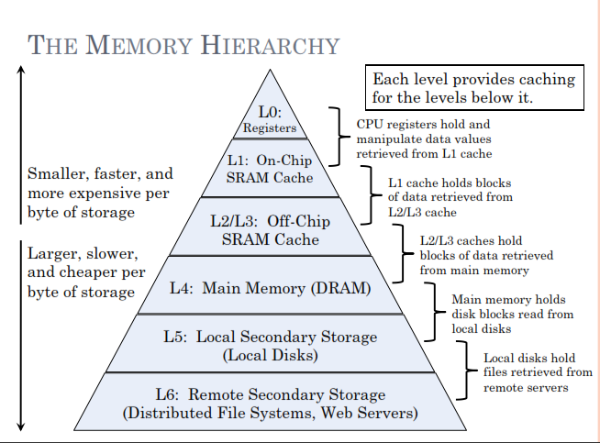
Memory Hierarchy

Slide 13
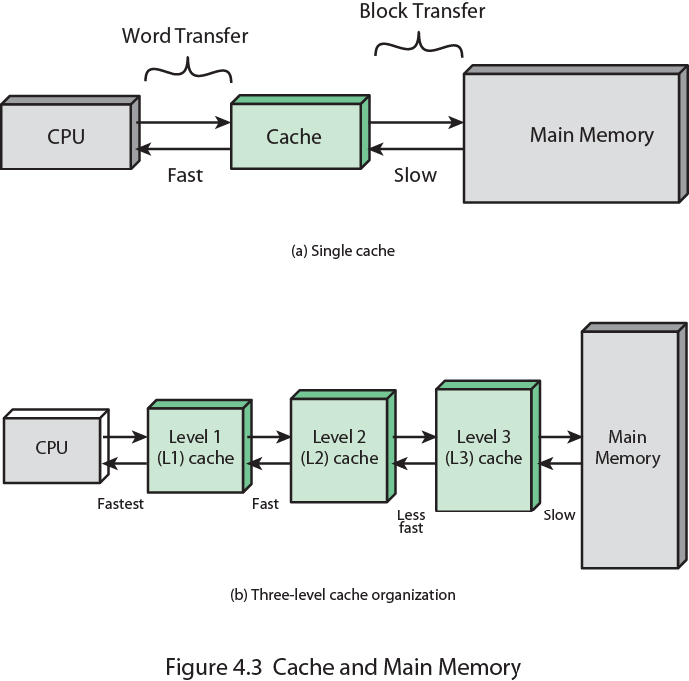
Memory Hierarchy : Cache

Slide 14
Motivation For Cache:

Slide 15
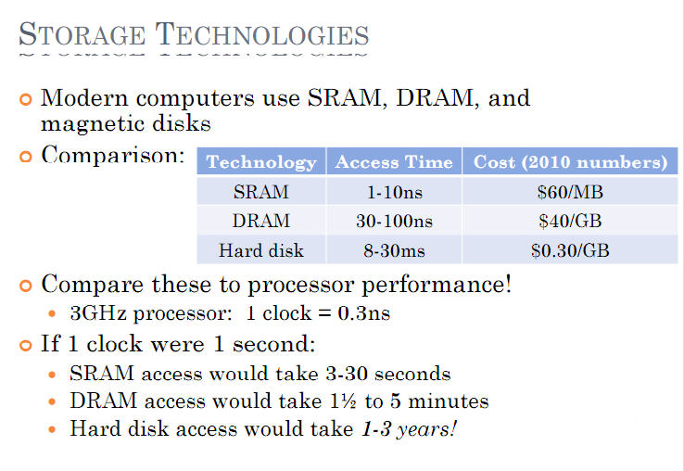
Motivations for Cache :

Slide 16
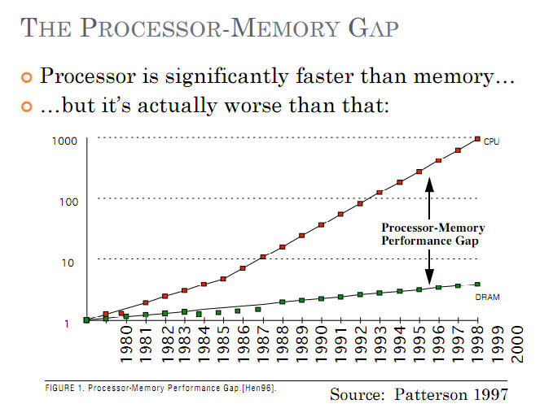
Motivations for Cache :

Slide 17
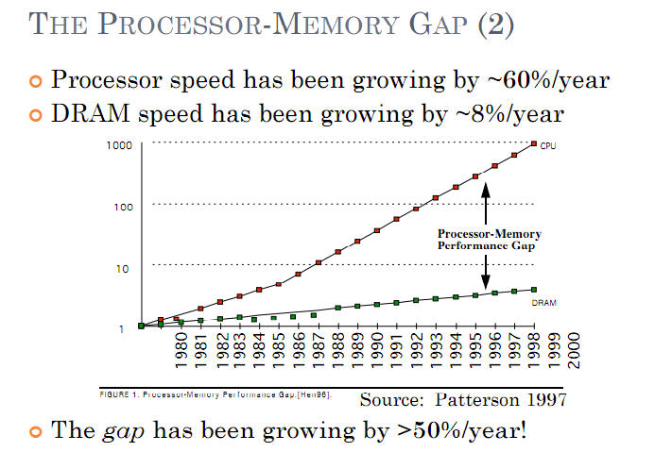
Motivations for Cache :

Slide 18
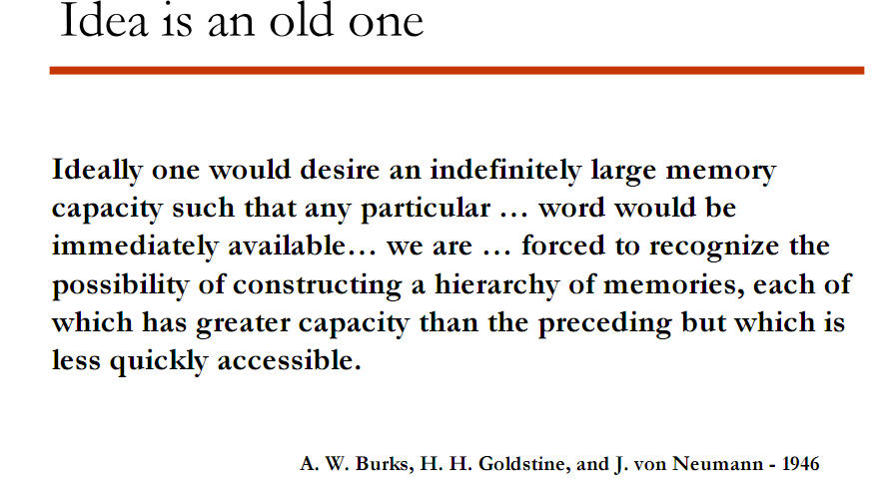
Motivations for Cache : The Quote

Slide 19
Week 08 : Lecture 15-16
Cache Working Principle:

Slide 20
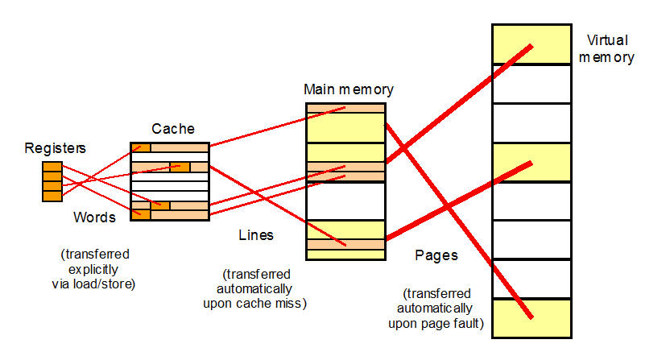
Principle of Working : Cache

Slide 21
Cache operation – overview
CPU requests contents of memory location
Check cache for this data
If present, get from cache (fast)
If not present, read required block from main memory to cache.(slow)
Then deliver from cache to CPU
Cache includes tags to identify which block of main memory is in each cache slot.

Slide 22
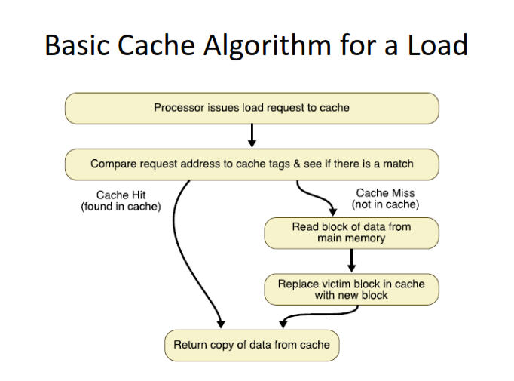
Example :

